Slide 1
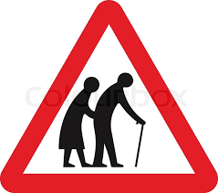
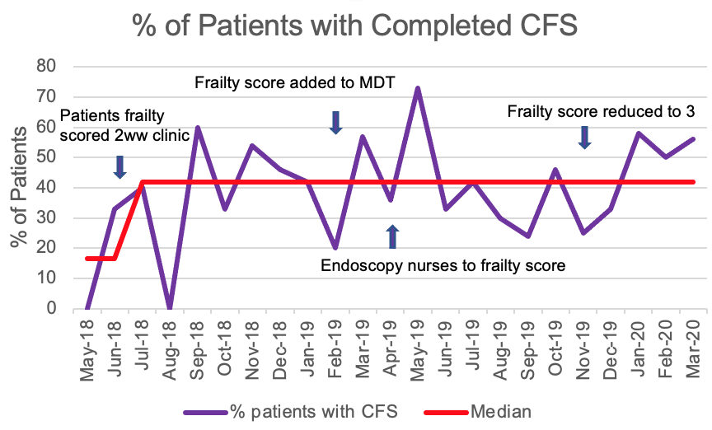
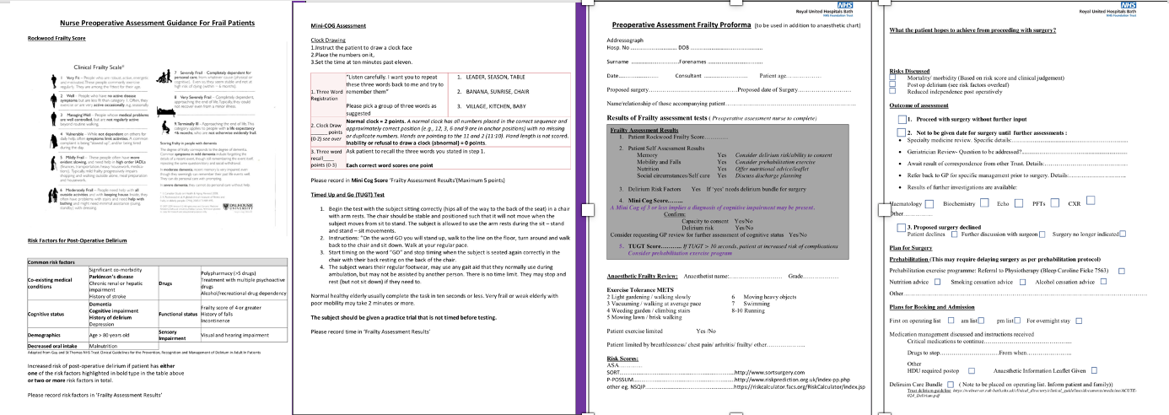
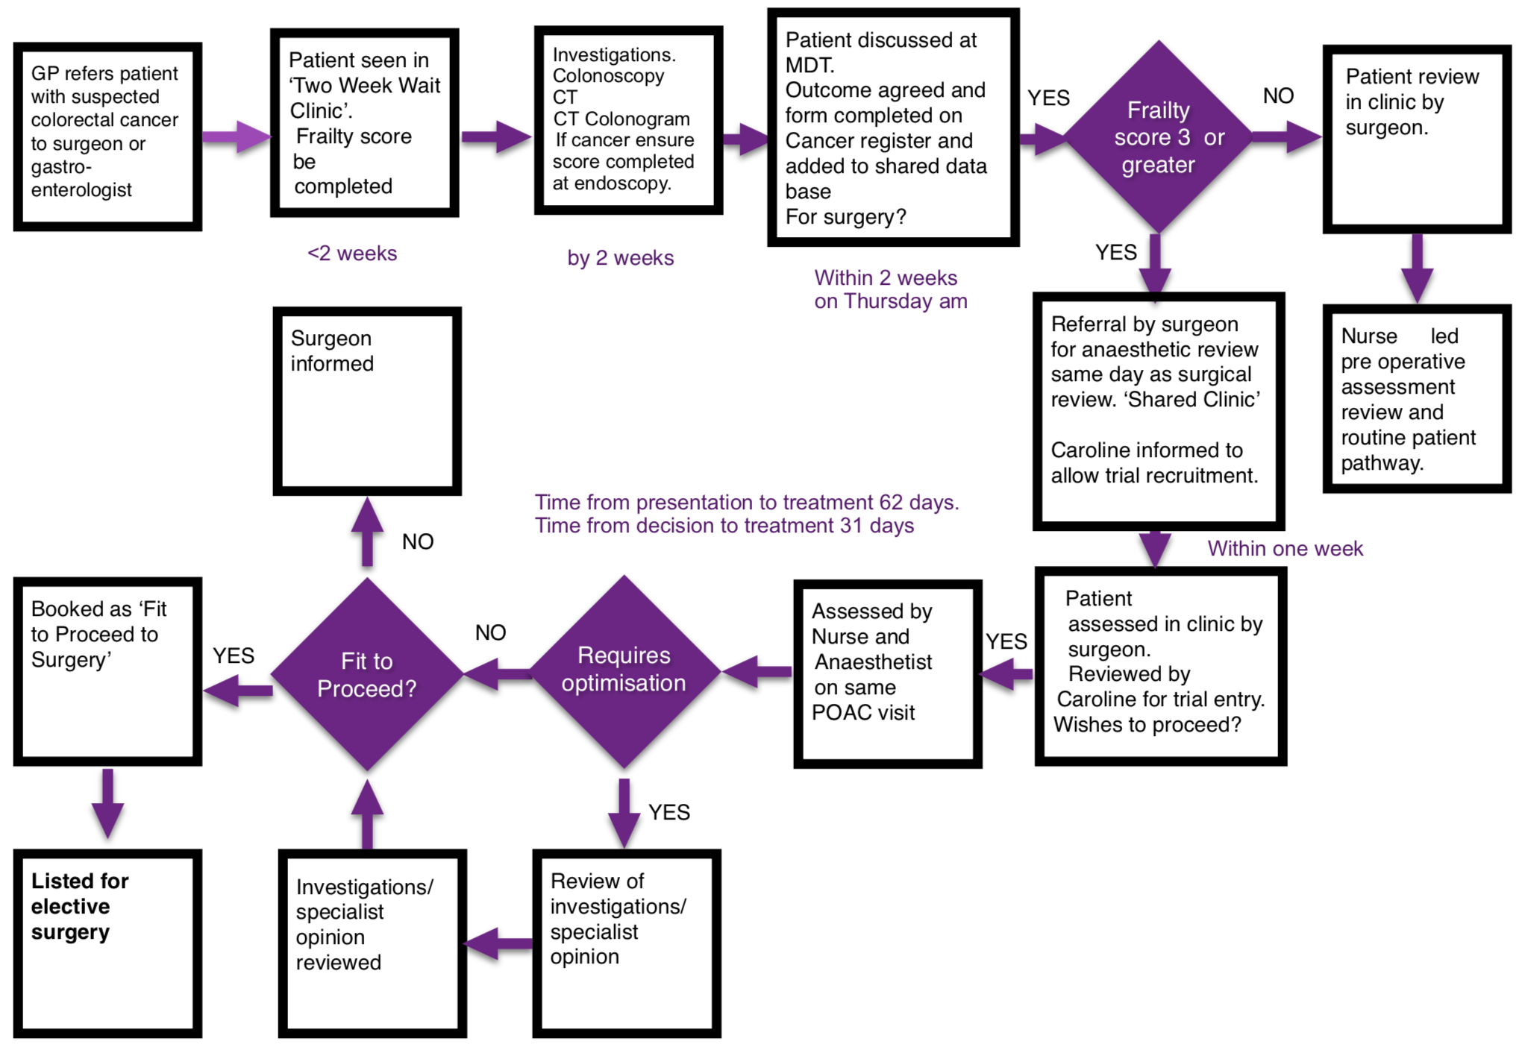
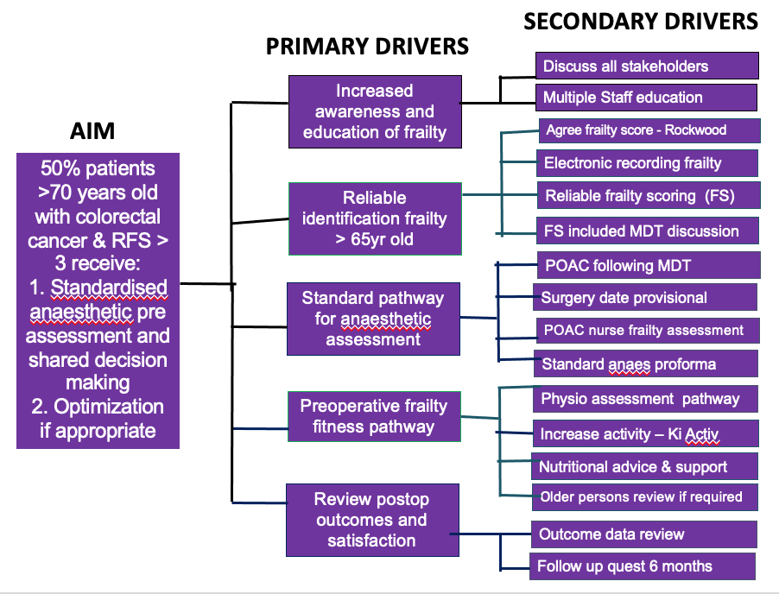
Improvement in Assessment of Frail Elderly Patients
Dr R Awan, Dr D Choudhuri and Dr L Jordan - Royal United Hospital Bath NHSFT, Department of Anaesthesia
INTRODUCTION
RESULTS
FRAILTY
Frailty assessment is recommended nationally preoperatively to predict outcome / facilitate shared decision-making and evaluate modifiable risk factors (3)
The Rockwood Clinical Frailty Scale (CFS) had been introduced in our Trust but preoperative use was not reliable and there was no formal specific anaesthetic evaluation for frail patients.
In May 2018, we identified 25% of patients aged >70 presenting for colorectal surgery had a CFS > 5 but none were specifically referred for preassessment on the basis on frailty.
The percentage of patients aged > 70 with completed preoperative CFS increased from 0% to 41% by March 2020 (Fig 3)
and the percentage of patients with CFS >3 receiving an anaesthetic frailty assessment increased from 0% to 66%.
Length of stay for all patients >70 undergoing this surgery improved from a median of 7 days (2 -67 ) in 2017/18 to a median of 6 days ( 2-65) between June 2018 and Dec 2020.
Anaesthetic preoperative frailty evaluation was established with a standard proforma ( fig 4) a specific referral process and clinic and a core group of specialist anaesthetists identified.
Patients reviewed had a mean age 80 (71-87), a CFS range 2-6 and mean time to review of 8.3 days (1 – 17).
71% of those assessed proceeded to surgery and 41% were recruited to a virtual prehabilitation programme.
The remaining patients either opted for no treatment or conservative alternatives. Patient Satisfaction was high.
A geriatric syndrome involving a reduced physiological reserve in multiple organ systems causing adverse outcomes as a result of minor external stressors
14% over 60 Frail
68% by age 90 (1)
8% population >75
23% surgical procedures
Issue: Higher incidence of poor outcomes
May never regain preoperative fitness (2)
Fig. 3 (Right)
Run Chart -. Percentage of patients frailty scored prior to referral to POAC
Fig. 4 (Left)
Standardised anaesthetic Proforma
Fig. 4:
Standardised Anaesthetic Proforma
Fig. 3 : Run Chart. Percentage of patients frailty scored prior to referral to POAC
AIM: Improve assessment and shared decision-making of frail patients aged >70 presenting for elective colorectal cancer surgery by 50% by December 2020
METHODS
Two areas were addressed in a pilot patient group presenting for colorectal cancer surgery: Reliable identification of frail patients and implementation of a specific anaesthetic preoperative frailty evaluation.
A measurement strategy was established and baseline measures collected.
A multidisciplinary stakeholder group was established and considerable planning occurred, including development of a process map, identifying a complicated preoperative pathway, resulting in implementation of CFS early than expected. A driver diagram supported planning.
Multiple tests of change (PDSAs) enabled the process to develop with extensive learning , including adding CFS to colorectal cancer MDT to inform the decision-making process.
Training was delivered to surgeons, anaesthetists, preoperative nurses and endoscopy teams, ensuring full engagement.
A standardised preoperative assessment form was developed with geriatrician input, which was tested and developed following direct feedback from POA nurses and anaesthetists.
A satisfaction survey following anaesthetic review provided useful patient feedback
‘Really appreciated the time taken to communicate with Mum’
‘I found it invaluable to feel prepared for the spectrum of possibilities of what it might look like post op’
CONCLUSION
• Awareness of frailty has increased across the MDT with significant engagement and enthusiasm to improve processes.
• Stakeholder engagement and education was crucial due to the complicated pathway and number of teams involved.
• A standard frailty assessment form has been successfully developed and is now in standard use, as well as a standard process for anaesthetic frailty assessment with specialist anaesthetists to ensure high quality assessment and shared decision making. This will now be spread to patients presenting for other surgery.
• Opportunities for improving fitness and reducing perioperative risk have been identified and prehabilitation plans developed.
• Establishing reliable CFS recording was challenging and although scoring improved, it remained <50% patients. This was due to multiple steps in the diagnostic process, as well as training being interrupted by the Covid Pandemic. However, the Trust recently adopted ‘MyPreOp’, an online tool which enables CFS recording routinely, so this will now be more reliable.
• A process for delirium risk assessment, as well as a tool for minimising delirium postoperatively, was also developed as part of the work but was difficult to test due to the Covid pandemic. This will be rolled out in 2021.
Fig. 1 (Left))
Process map of journey for patients over 70 years presenting for elective colorectal cancer surgery
Fig. 2 (Right)
Driver Diagram
REFERENCES
1. Hubbard et al. Patient frailty: the elephant in the operating room. Anaesthesia 2014,69 (Suppl. 1), 26-34
2.. Liane et al. From Preoperative Assessment to Preoperative Optimization of Frailty. JAMA Surg. doi10.1001/jamasurg.2018.0214.
3. Association of Anaesthetists of Great Britain and Ireland Guidelines; Peri-operative care of the Elderly 2014
Acknowledgement: The work was supported by NIAA Grant from Association of Anaesthetists in 2018/19

